Slide 1
Науково-практичний студентський круглий стіл «ОБЛІК і ЗВІТНІСТЬ В ІНФОРМАЦІЙНОМУ ЗАБЕЗПЕЧЕННІ СТАЛОГО РОЗВИТКУ ЕКОНОМІКИ»
Environmental reporting is the way to the EU
Екологічна звітність – шлях до ЄС
Bo Nyhus. Investment Director NEFCO – Nordic Environment Finance Corporation, Finland
Бо Нюхус, директор з інвестицій NEFCO, Фінляндія

Slide 2
Accounting and Accountants are important in a society ”going green” or becoming sustainable
”Environmentalists” have for decades aimed for same reporting rigor and standardization of environmental data as used in Financial Accounting…. and has progressed a lot
Society is demanding more and more from companies – actions and information about actions.
Earning money is far from enough for ”Licence to Operate”
The annual accounts will become the central document, with standardized data, for communication Financial Data and Impact Data and those accounts will be prepared by Accountants

Slide 3
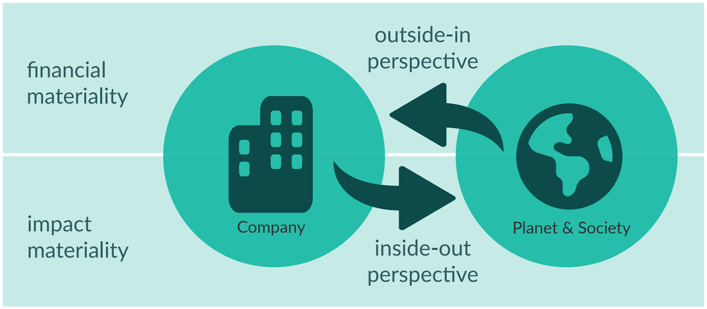

Slide 4
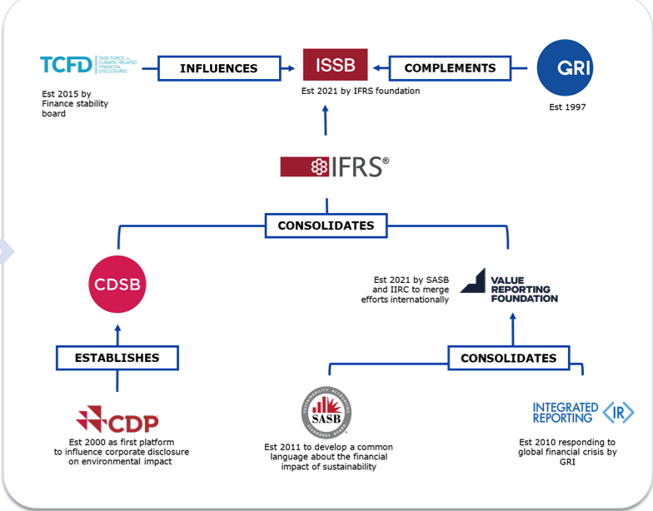

Slide 5
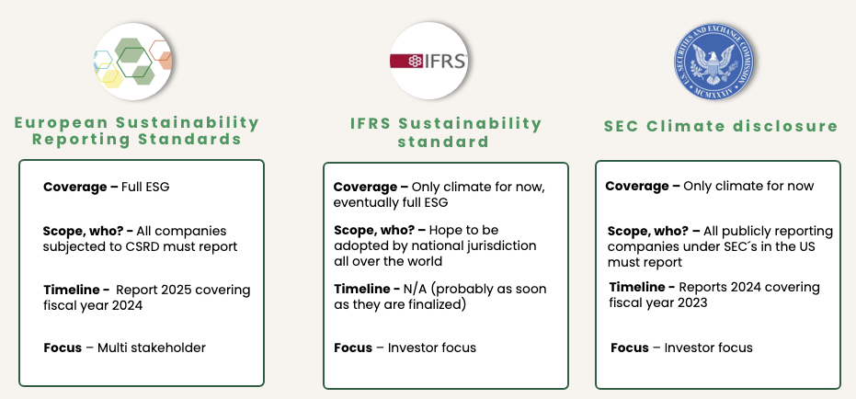

Slide 6
Accountants’ role and importance will grow
It is well documented that ESG factors are risks and opportunities influencing the financial performance and status of the company
Future Audited Financial Statements will/shall include ESG/Sustainability information to give a fair and reasonable picture of the company
Financial data only, is not enough
Accountants and Auditors will be among the only profession who can provide data assurance on information in the Integrated Annual Accounts
But it will require training and requalification

