Slide 1




State University of Trade and Economy
Scientific and practical student round table
Integrated reporting as a tool for information provision of sustainable development
Scientific advisor:
Valentyna Kostyuchenko, Doctor of Economics, Professor
Student 3rd year of study Yana Dmytrenko, FMTP, Management of foreign economic activity
November 23, 2023, Kyiv

Slide 2
State University of Trade and Economy
Introduction
As rapid changes transform the economic and social landscape, companies require more sophisticated, relevant corporate information systems that go beyond just processing data to provide strategic insights and analytical data that can inform critical decisions and satisfy the diverse needs of various users, from management teams to external stakeholders such as partners, regulators, and customers.

Slide 3
State University of Trade and Economy
Overview
Integrated reporting has emerged as a new holistic accounting method focused on sustainable development, incorporating financial, production, human, intellectual, natural, and social capital information to paint a comprehensive picture of a company's overall performance and strategy, linking traditional financial and management reporting together with corporate governance, executive remuneration, and sustainability reporting to better meet the complex informational needs of both internal management and external stakeholders.

Slide 4
State University of Trade and Economy
Principles
Guiding principles of integrated reporting include a focus on:
  sustainability impacts across multiple levels from local communities to the global society,
  clear interconnectivity between the different information components that allows users to understand relationships,
  meet the information needs of diverse stakeholders from investors to policymakers,
  maintaining close strategic alignment with corporate value creation, and high standards for relevance, reliability and completeness when it comes to reporting information and data.
INTEGRATED REPORTING IN CONDITIONS OF SUSTAINABLE DEVELOPMENT, O. Kolisnyk 2022

Slide 5
State University of Trade and Economy
Benefits
Adopting integrated reporting provides benefits including improving public trust and transparency, confirming the integration of sustainability considerations into all aspects of the business, increasing awareness of the company's myriad impacts among both internal and external stakeholders, and enhancing the assessment of risks, opportunities and paths to value creation in the short and long term.
Вісник МСФЗ, інтегрована звітність, 2017

Slide 6
State University of Trade and Economy
Example
As an early pioneer of integrated reporting, having published its first integrated report back in 2005, the Italian high-end fashion brand Monnalisa serves as an illuminating example of integrated reporting in practice, notably highlighting the importance of intangible assets like its brand and goodwill, while more recent reports shift focus to core stakeholder interests and clear communication of how the company creates sustainable value, supporting strategy execution and performance management using key indicators.

Slide 7
State University of Trade and Economy
Global Trends
Кeviewing adoption data reveals the accelerating uptake of integrated reporting across the corporate landscape worldwide, with over 171,340 integrated reports published by nearly 25,000 global companies to date, predominantly led by the US, UK, Japan, Germany, Spain and other developed nations where the practice is becoming standard, and the numbers growing each year.

Slide 8
State University of Trade and Economy
Ukraine Status
While integrated reporting implementation remains in a maturation phase in Ukraine, with only 9 Ukrainian companies publishing integrated reports as of 2020, it presents opportunities to experiment with innovative approaches aligned to integrated reporting principles that address pertinent issues not captured by traditional Ukrainian reporting frameworks.
ІНТЕГРОВАНА ЗВІТНІСТЬ ПІДПРИЄМСТВА: СТАН ТАПЕРСПЕКТИВИ РОЗВИТКУ, T. Mulyk, 2019

Slide 9
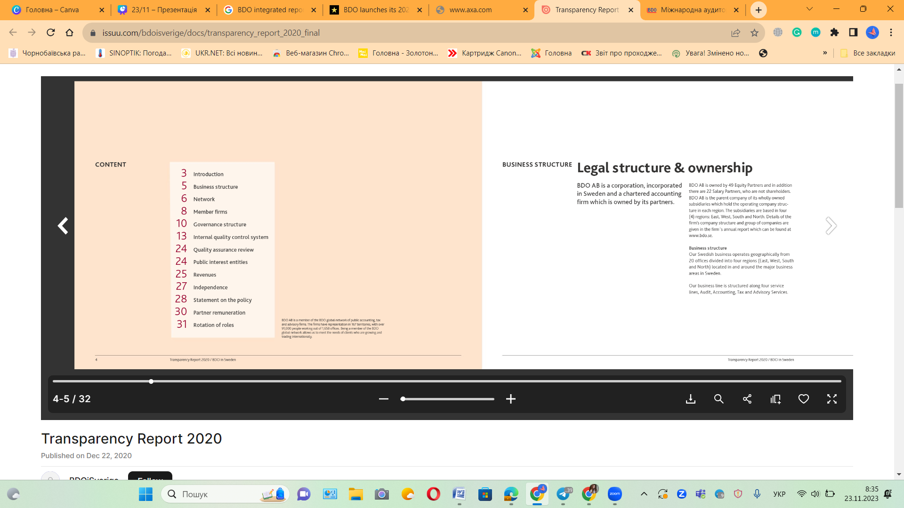

Slide 10
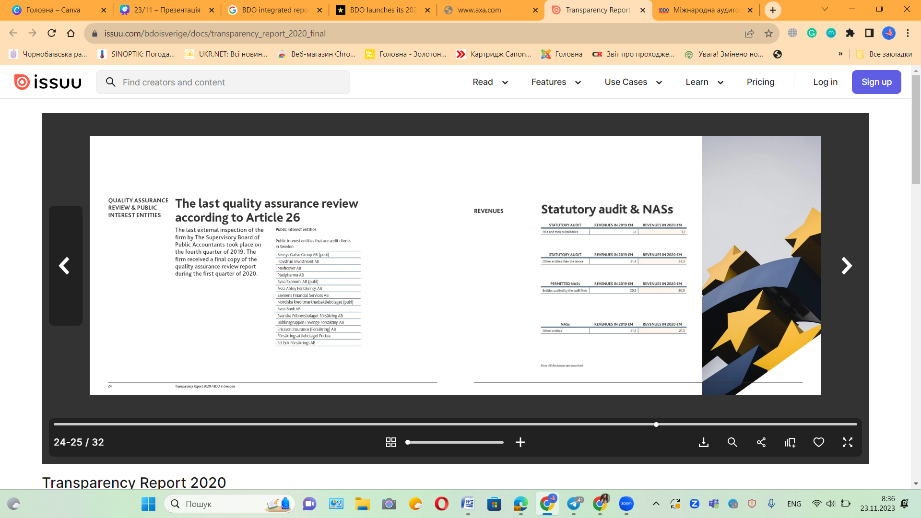

Slide 11
State University of Trade and Economy
Conclusion
The adoption of integrated reporting has become increasingly critical for enterprises in Ukraine across sectors to manage and ensure sustainable development beyond pure financials, holistically displaying their tangible impacts on social, human, and environmental levels, which Ukrainian companies must embrace.

Slide 12
State University of Trade and Economy
Thank
You
Presented by student of 3-7a Yana Dmytrenko

